Slide 1
Advanced Concepts
Special Pod Cases. Autoscaling and Scheduling
Daemon Sets and Jobs. Ingress
SoftUni Team
Technical Trainers
Software University
https://about.softuni.bg

Slide 2
Have a Question?
sli.do
#Kubernetes
https://www.facebook.com/groups
/KubernetesOctober2021
Notes:
2

Slide 3
Homework Progress
Submit M3 until 23:59:59 on 05.11.2021
Submit M4 until 23:59:59 on 12.12.2021
Submit M5 until 23:59:59 on 19.12.2021

Slide 4

Previous Module (M4)
Quick overview

Slide 5
Table of Contents
(Persistent) Volumes and Claims
Configuration Maps and Secrets
Stateful Sets
5
Notes:
5

Slide 6

This Module (M5)
Notes:
6

Slide 7
Table of Contents
Static Pods and Multi-container Pods
Autoscaling and Scheduling
Daemon Sets and Jobs
Ingress Resources and Controllers
7
Notes:
7

Slide 8
Static Pods
Notes:
8

Slide 9
Static Pods
Static Pods are managed directly by the kubelet
The API server is not looking after them
The spec of a static Pod cannot refer to other API objects
Their manifests are standard but are stored in a specific folder
Usually, this is /etc/kubernetes/manifests
And it is regulated by the kublet configuration file
We can serve static Pods from the local filesystem or the web
https://kubernetes.io/docs/tasks/configure-pod-container/static-pod/

Slide 10
Multi-container Pods
Notes:
10

Slide 11
Multi-container Pods
Pods often have just one container
However, we may want do add more than one
This may be due to the need of a helper process, or container with the same lifecycle, etc.
There are three common design patterns for this
Sidecar
Adapter
Ambassador
Single node patterns
(yes, there are multi node patterns as well)
…

Slide 12
Sidecar Pattern
Sidecar containers enhance the main container
For example, it may sync the local file system with a remote repository
Or it may parse the logs of the main container and send them somewhere
In any case, both share the same filesystem
main
sidecar
filesystem
https://kubernetes.io/blog/2015/06/the-distributed-system-toolkit-patterns/

Slide 13
Adapter Pattern
Adapter containers are used to standardize and normalize the output
This may be done in order to prepare it for a monitoring system
This way, no matter the actual application or applications, the monitoring system will receive prepared data flow
monitoring
solution
main
adapter
filesystem
https://kubernetes.io/blog/2015/06/the-distributed-system-toolkit-patterns/

Slide 14
Ambassador Pattern
Ambassador containers proxy a local connection to the world
The main container is connecting to a port on the localhost
The ambassador container proxies the connection to the appropriate target
Usually, this is used for providing access to a database
For example, local one (when in test/dev) or a remote one (when in prod)
db1
main
adapter
db2
https://kubernetes.io/blog/2015/06/the-distributed-system-toolkit-patterns/

Slide 15
Init Containers
Notes:
15

Slide 16
The Special Case of Init Containers
Specialized containers that run before app containers in a Pod
Contain utilities or setup scripts not present in an app image
App Containers are specified via containers section and the Init Containers are specified via initContainers section
Init Containers always run to completion. If one of them fails, the kubelet repeatedly restarts it until it succeeds
Each Init Container must complete successfully before the next one starts
https://kubernetes.io/docs/concepts/workloads/pods/init-containers/

Slide 17

Practice
Live Exercise in Class (Lab)
Notes:
17

Slide 18
Autoscaling
Notes:
18

Slide 19
Autoscaling
Environments are not static but dynamic and changing
This applies to the running pods and the resources they need
Kubernetes, being a container orchestrator, has an answer. It offers the capability to perform autoscaling of resources
There are three types
Scale out the pods by increasing their replica count
Scale up the pods by increasing their resources limits
Scale out the cluster by increasing the number of nodes
https://cloud.redhat.com/blog/kubernetes-autoscaling-3-common-methods-explained

Slide 20
Scale Out Pods (Horizontal Pod Autoscaler)
The Horizontal Pod Autoscaler (HPA) automatically scales the number of pods in a replication controller, deployment, replica set or stateful set based on observed CPU utilization
It is implemented as a Kubernetes API resource and a controller
The resource determines the behavior of the controller
The controller periodically adjusts the number of replicas in a replication controller or deployment
The Horizontal Pod Autoscaler is implemented as a control loop, with a period controlled by a flag with default value set to 15 seconds
Both upscale and downscale intervals are also controlled by flags and their default value is set to 5 minutes
https://kubernetes.io/docs/tasks/run-application/horizontal-pod-autoscale/

Slide 21
Scale Up Pods (Vertical Pod Autoscaler)
The Vertical Pod Autoscaler (VPA) maintains the resource limits and requests for the containers in their pods up to date
It can adjust the requests based on the usage. It also maintains the ratio between requests and limits
Implemented via a Custom Resource Definition (CRD) object and has three components
Recommender monitors current and past resource consumption and provides recommended values
Updater checks which resources have correct resources set and if not, kills them in order to be recreated with updated values
Admission Plugin sets the correct resource requests on new pods
https://github.com/kubernetes/autoscaler/tree/master/vertical-pod-autoscaler

Slide 22
Scale Out Cluster Nodes (Cluster Autoscaler)
Like the HPA but for cluster nodes
Based on cluster utilization it can change the number of nodes
This is useful also for cost optimization
It checks for pods that cannot be scheduled on existing nodes. Then checks if node addition will solve the issue
In the same manner, if pods can be rescheduled on other nodes to utilize them better, they will be evicted from a node and then the node will be removed
https://github.com/kubernetes/autoscaler/tree/master/cluster-autoscaler

Slide 23
Scheduling
Notes:
23

Slide 24
Taints and Tolerations
Taints are applied to nodes and allow them to repel pods
They have key, value and taint effect and are set like kubectl taint nodes node1 key1=value1:NoSchedule
Effect must be NoSchedule , PreferNoSchedule or NoExecute
Tolerations are applied to pods and allow them to schedule on nodes with matching taints
They are specified with key, operator (Exists or Equal), value (if the operator is equal) and effect
https://kubernetes.io/docs/concepts/scheduling-eviction/taint-and-toleration/

Slide 25
Node Selectors
A pod can be constrained to run only on particular nodes
One of the ways to do this is to use node selectors
nodeSelector is a field part of the pod specification
It specifies a map of key-value pairs
For a pod to be able to run on a node, the node must have all indicated key-value pairs (it may have others as well)
https://kubernetes.io/docs/concepts/scheduling-eviction/assign-pod-node/

Slide 26
Daemon Sets and Jobs
Notes:
26

Slide 27
Workload Resources
So far, we covered the following high level workload resources
ReplicationController
ReplicaSet
DaemonSet
StatefulSet
There are a few others that we will cover now
DaemonSet
Job and CronJob

Slide 28
Daemon Sets
Ensures that all (or some) Nodes run a copy of a Pod
As nodes are added to the cluster, Pods are added to them
As nodes are removed from the cluster, those Pods are garbage collected
Deleting a DaemonSet will clean up the Pods it created
https://kubernetes.io/docs/concepts/workloads/controllers/daemonset/

Slide 29
Jobs
A Job creates one or more Pods and ensures that a specified number of them successfully terminate
As pods successfully complete, the Job tracks the successful completions
When a specified number of successful completions is reached, the Job is complete
Deleting a Job will clean up the Pods it created
The Job object will start a new Pod if the first Pod fails or is deleted
They can run Pods either in sequence or in parallel
https://kubernetes.io/docs/concepts/workloads/controllers/job/

Slide 30
Cron Jobs
A CronJob creates Jobs on a repeating schedule
One CronJob object is like one line of a crontab (cron table) file
CronJobs are useful for creating periodic and recurring tasks, like running backups, reports generation, sending emails, etc.
https://kubernetes.io/docs/concepts/workloads/controllers/cron-jobs/

Slide 31
Practice
Live Exercise in Class (Lab)
Notes:
31

Slide 32
Ingress Resources and Controllers
Notes:
32

Slide 33
Ingress
Ingress exposes HTTP and HTTPS routes from outside the cluster to services within the cluster
Traffic routing is controlled by rules defined on the Ingress resource
We must have an Ingress controller to satisfy the Ingress
Types
Single service (default backend)
Fanout
Name based virtual hosting
TLS
https://kubernetes.io/docs/concepts/services-networking/ingress/

Slide 34
Ingress Controllers
Ingress controllers are not started automatically with a cluster
Kubernetes as a project supports and maintains AWS, GCE, and nginx ingress controllers
Some of the others include HAProxy, Istio, Contour, etc.
We may deploy any number of ingress controllers within a cluster
Then, when we create one, we must annotate it with the appropriate Ingress Class
https://kubernetes.io/docs/concepts/services-networking/ingress-controllers/

Slide 35
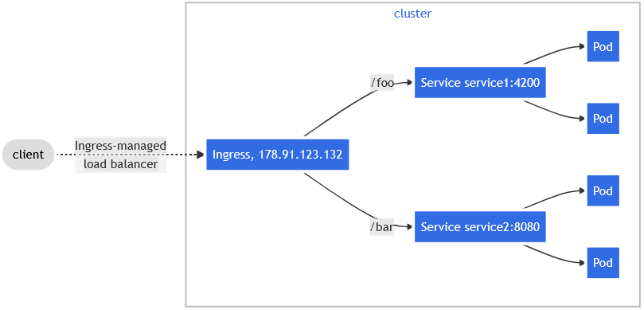
Fanout
Routes traffic from a single IP address to more than one Service, based on the HTTP URI being requested
https://kubernetes.io/docs/concepts/services-networking/ingress/#simple-fanout

Slide 36
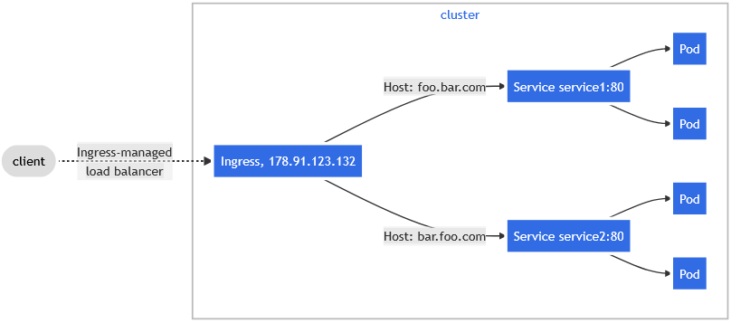
Name based virtual hosting
Supports routing HTTP traffic to multiple host names at the same IP address
https://kubernetes.io/docs/concepts/services-networking/ingress/#name-based-virtual-hosting

Slide 37
Questions?
Notes:
37

Slide 38










SoftUni Diamond Partners

Slide 39



Educational Partners

Slide 40

License
This course (slides, examples, demos, exercises, homework, documents, videos and other assets) is copyrighted content
Unauthorized copy, reproduction or use is illegal
© SoftUni – https://about.softuni.bg/
© Software University – https://softuni.bg
Notes:
40

Slide 41
Trainings @ Software University (SoftUni)
Software University – High-Quality Education, Profession and Job for Software Developers
softuni.bg, about.softuni.bg
Software University Foundation
softuni.foundation
Software University @ Facebook
facebook.com/SoftwareUniversity
Software University Forums
forum.softuni.bg
Notes:
41

